Slide 1
Tweet Summarization of a topic on the basis of Sentiment Analysis
5th Semester Mini Project (IPRJ505P)
Presented By,
Nilotpal Pramanik (IRM2016501)
Rahul Chanderiya (IIM2016002)
Ankit Kumar Gupta (IHM2016004) Neil Syiemlieh (IIT201125)
Ashutosh Yelgulwar (IIM2016006)
Under the Supervision
Dr. Krishna Pratap Singh
Mr. Upendra Pratap Singh
Ms. Daisy Monika Lal

Slide 2
ABSTRACT
Sentiment Analysis is a specific machine learning approach to analyze the human sentiments about the text data like tweets of twitter.
For a particular topic in twitter different users are providing different impacts or reviews.
So to deal with this particular problem in this project we are analyzing the human sentiments of a specific topic based on the twitter data.
We are only focusing on positive and negative sentiments in this project.
Next we are summarizing the already classified tweets as the text data with respect to the sentiments.

Slide 3
INTRODUCTION
Twitter is one of the most popular micro-blogging platform, allowing users to have a personal news feed.
Sentiment analysis focuses on analyzing people’s opinions, feelings, attitudes, and emotions with respect to a specific topic.
To analyze the opinions in the texts it is very common to rate them with a polarity and thus be able to classify the tweets among two categories: positive and negative.

Slide 4
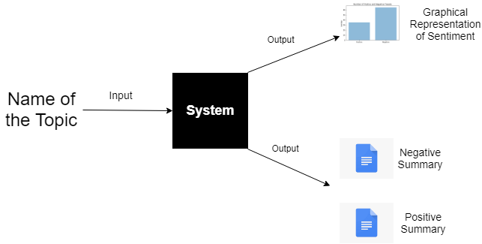

Slide 5
OBJECTIVES
Graphical representation of Human Sentiment analysis on a specific topic
Positive Sentiment
Negative Sentiment
Text Summarization of the already classified tweets separately.
Positive Summary
Negative Summary

Slide 6
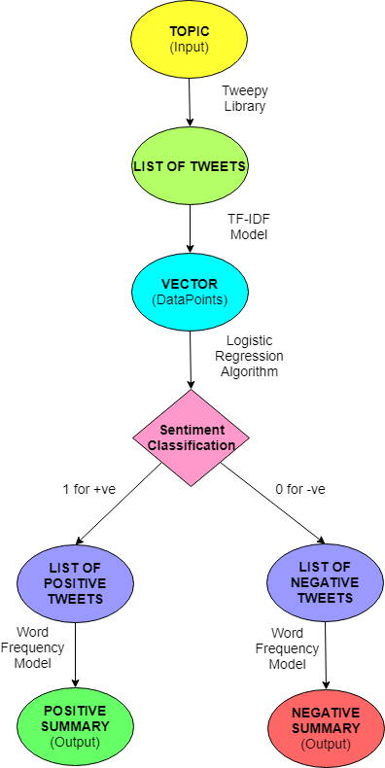
PROBLEM
FORMULATION

Slide 7
METHODOLOGY
Data Acquisition
Data acquisition is an extremely important phase, since without a well-defined and representative dataset the rest of the process is useless.
In our project we have used Tweepy Library to fetch the Twitter Data.

Slide 8
Data Processing
Preprocessing of text
Converting Processed Text into Data Points
TF-IDF Model

Slide 9
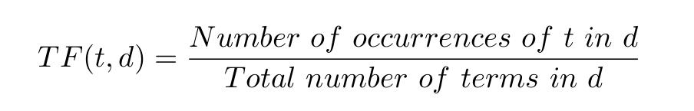
TF-IDF MODEL
TF (Term Frequency) :- The term frequency of a term ‘t’ in a document ‘d’ (tweet) measures how often the term occurs in that document. A term that occurs frequently is more important to that document's meaning.

Slide 10
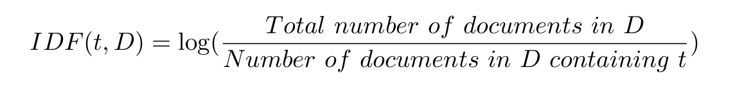

IDF (Inverse Document Frequency) :- The IDF of a term ‘t’ in a corpus ‘D’ (list of tweets) is the logarithm of the inverse fraction of the documents that contain that term. The more evenly distributed ‘t’ is throughout ‘D’, the lower its IDF.
TFIDF :- The TF-IDF of a term ‘t’ in a document ‘d’ within a corpus ‘D’ is the following product.

Slide 11

Machine Learning Approach
Logistic Regression :- Logistic Regression is used to Classify data in binary.In our project it is classifying sentiments as positive and negative.
y >= 0.5 Positive Sentiment
y < 0.5 Negative Sentiment

Slide 12
Sentiment Summarization
Extractive summarization :-
The entire corpus is reduced to only a certain number of the most relevant documents that capture the overall meaning of the source.
Extractive text summarization has been used to create both the positive and negative summaries.

Slide 13
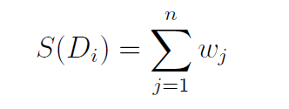
Summarization procedure
Find a score for each tweet and return only the first N > 0 tweets having the highest scores. That set of N tweets is our summarized text.
The score of a tweet ‘Di’ is obtained from the weights of the words present within that tweet (wj).
To obtain these word weights, we first create a count histogram of all the words in the positive corpus, which records the number of occurrences of every word in that corpus.
Normalize all the counts by dividing them all by the count of the most frequently occurring word. The normalized counts are the weights.

Slide 14

Input topic

Slide 15
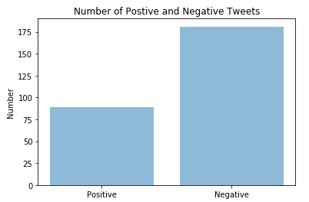
Graphical analysis

Slide 16
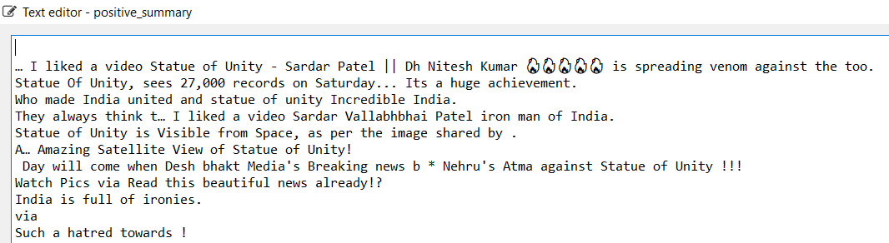
Positive Summary

Slide 17
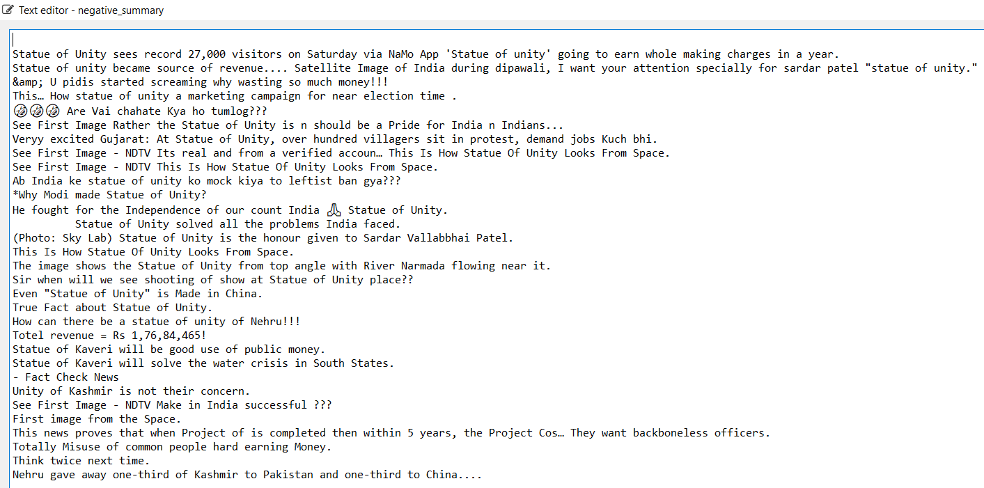
Negative Summary

Slide 18
Examples

Slide 19
TF-IDF Model

Slide 20
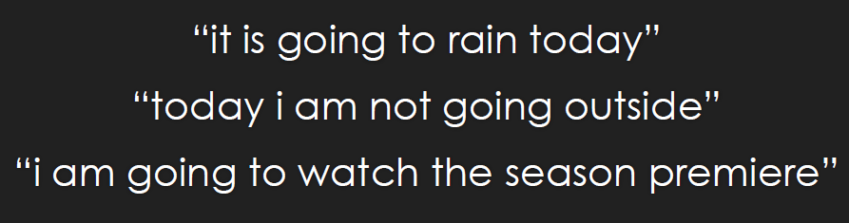

Slide 21
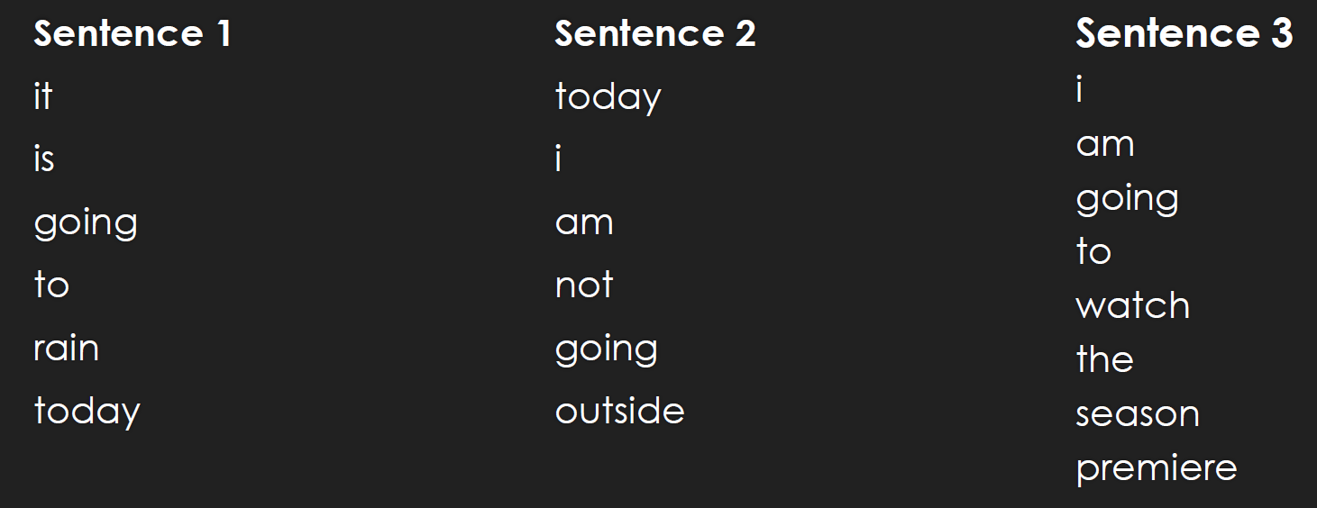

Slide 22
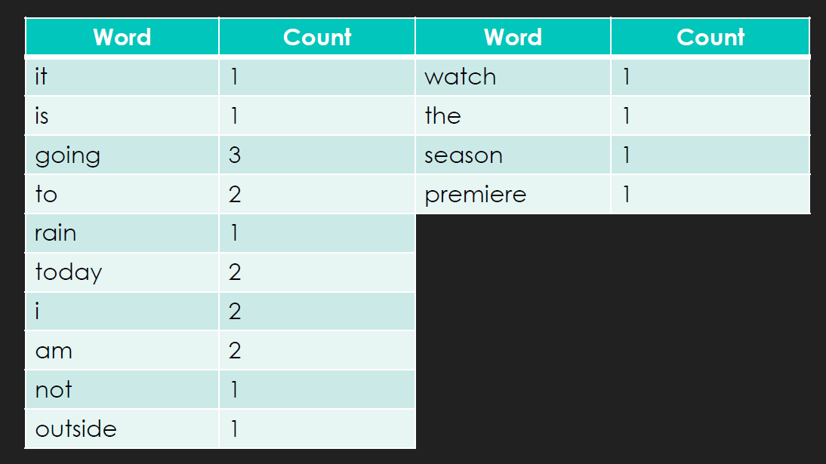

Slide 23
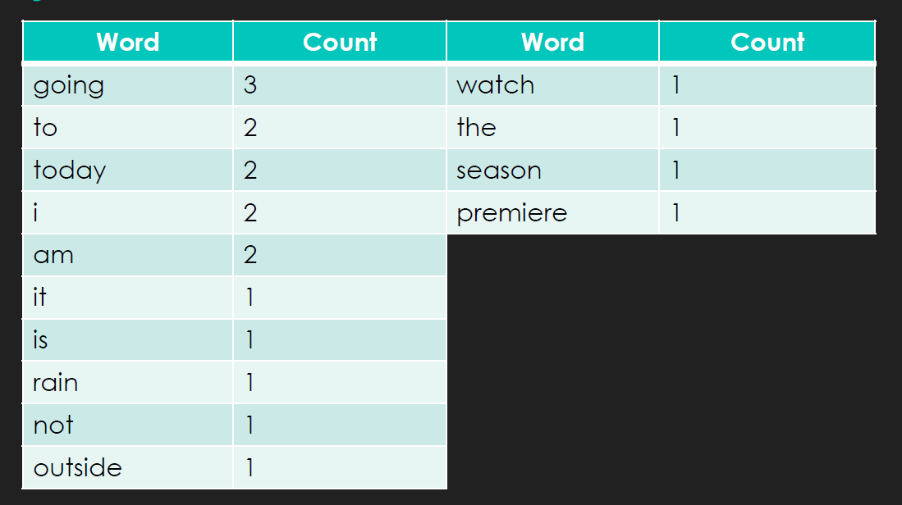

Slide 24
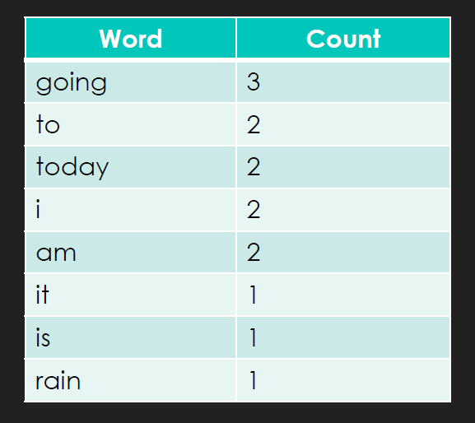

Slide 25
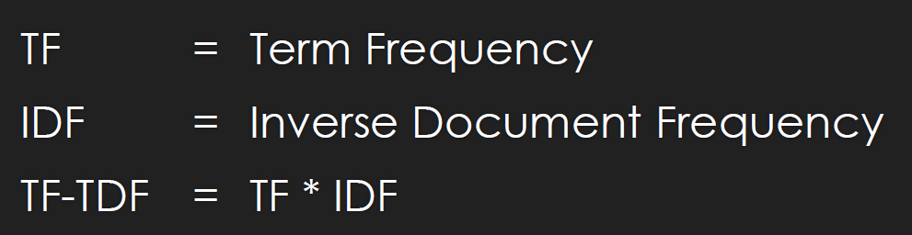

Slide 26
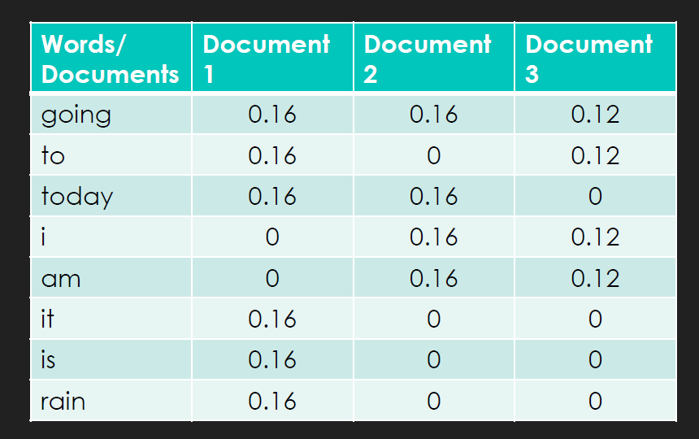

Slide 27
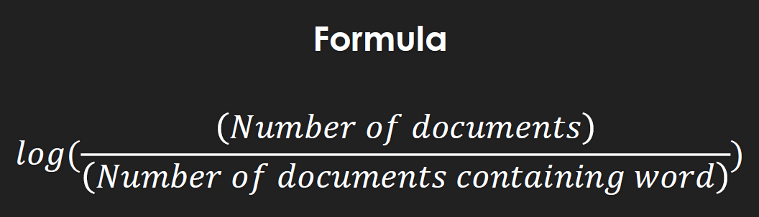

Slide 28
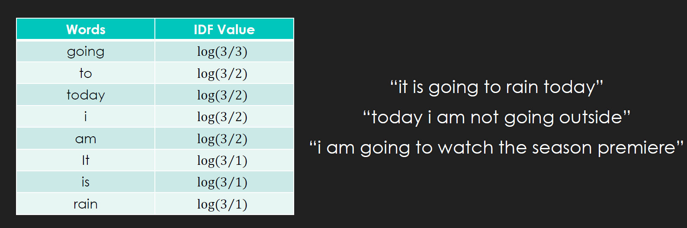

Slide 29
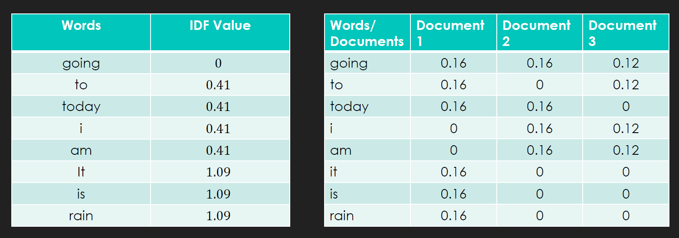

Slide 30
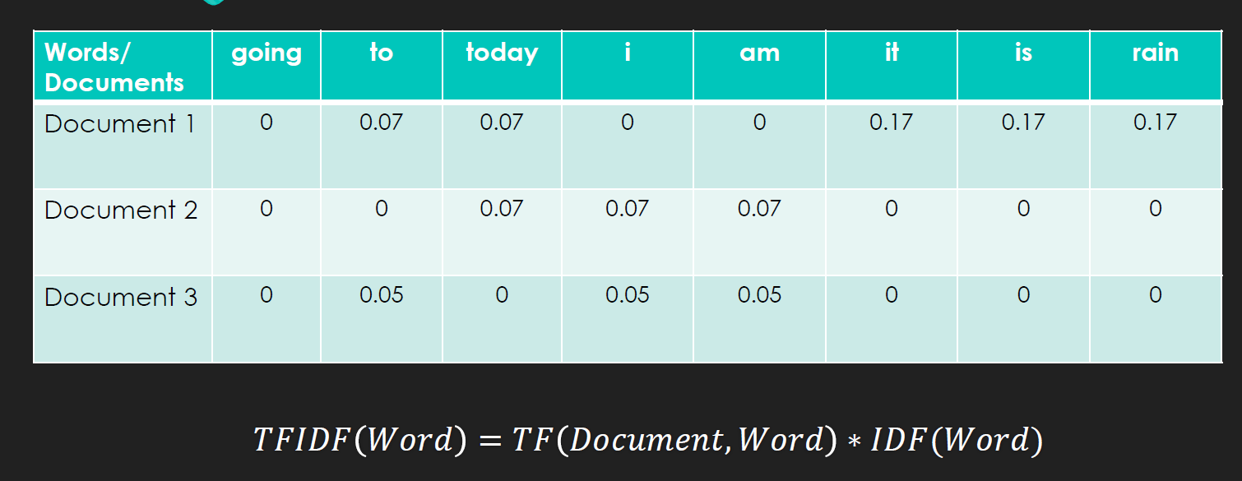

Slide 31
Logistic Regression

Slide 32
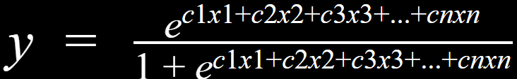
c_{i} = coefficients (logistic parameters)
x_{i} = independent variables (TF-IDF values)
y = dependent variable (sentiment)

Slide 33
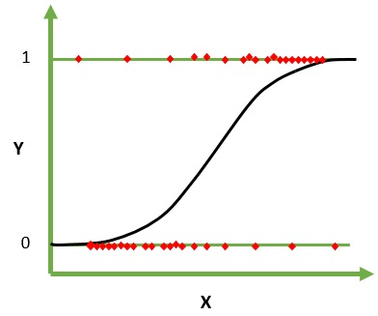

Slide 34
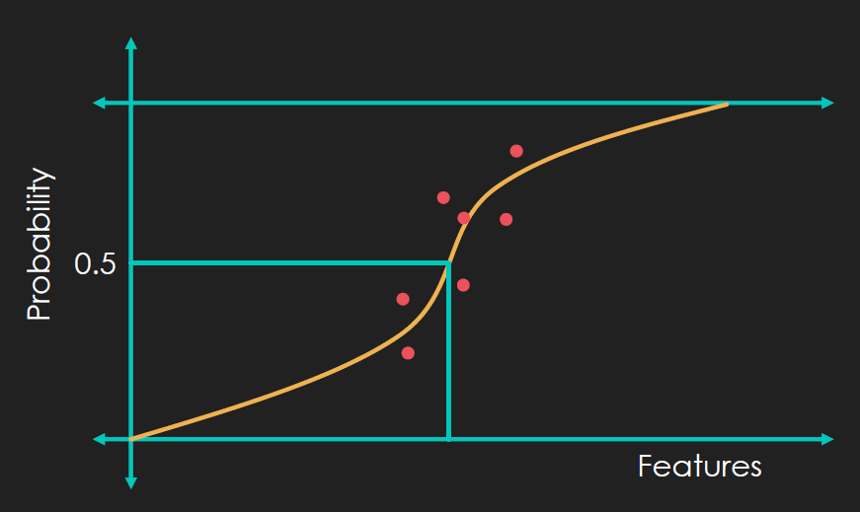

Slide 35
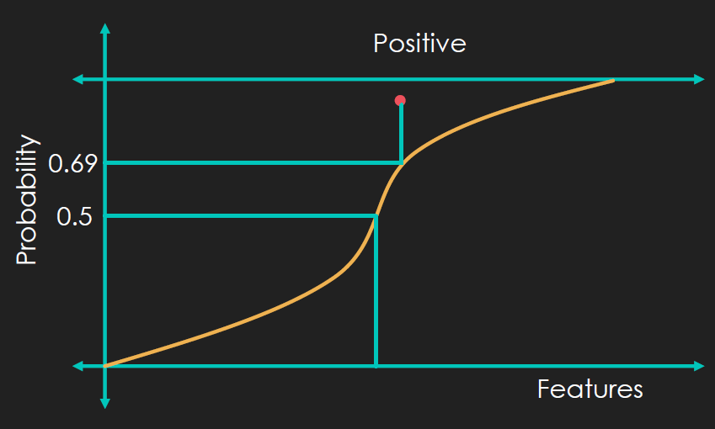

Slide 36
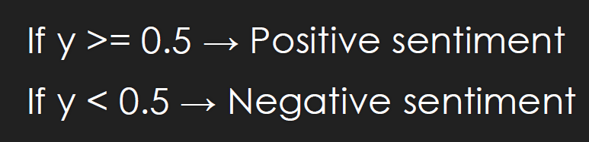

Slide 37
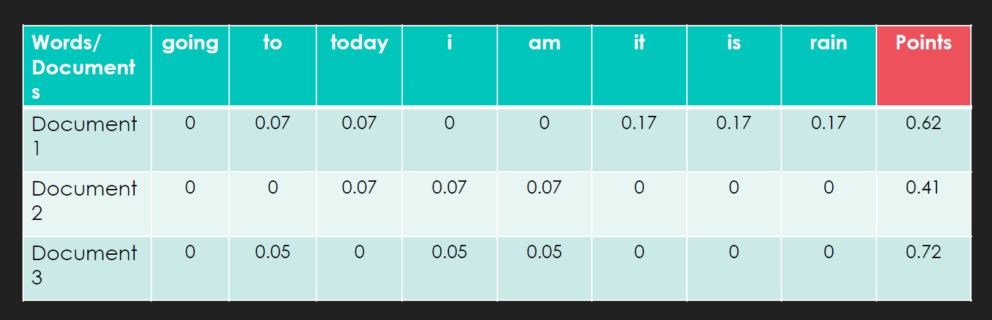

Slide 38
Text Summarization

Slide 39
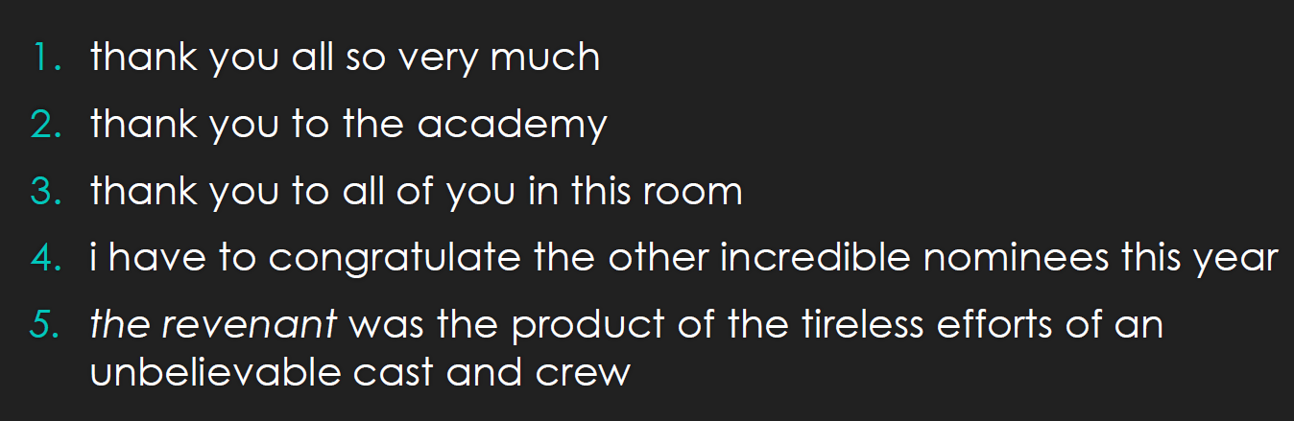

Slide 40
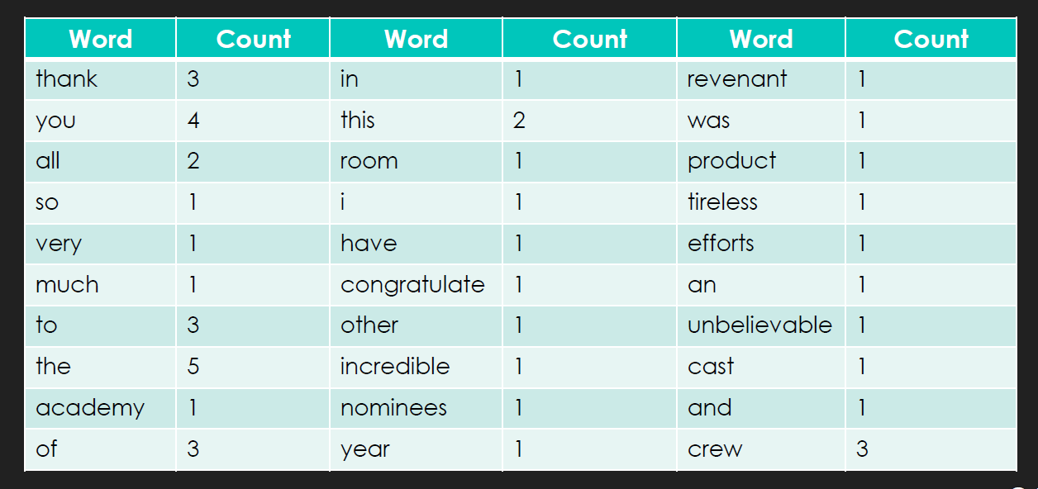

Slide 41
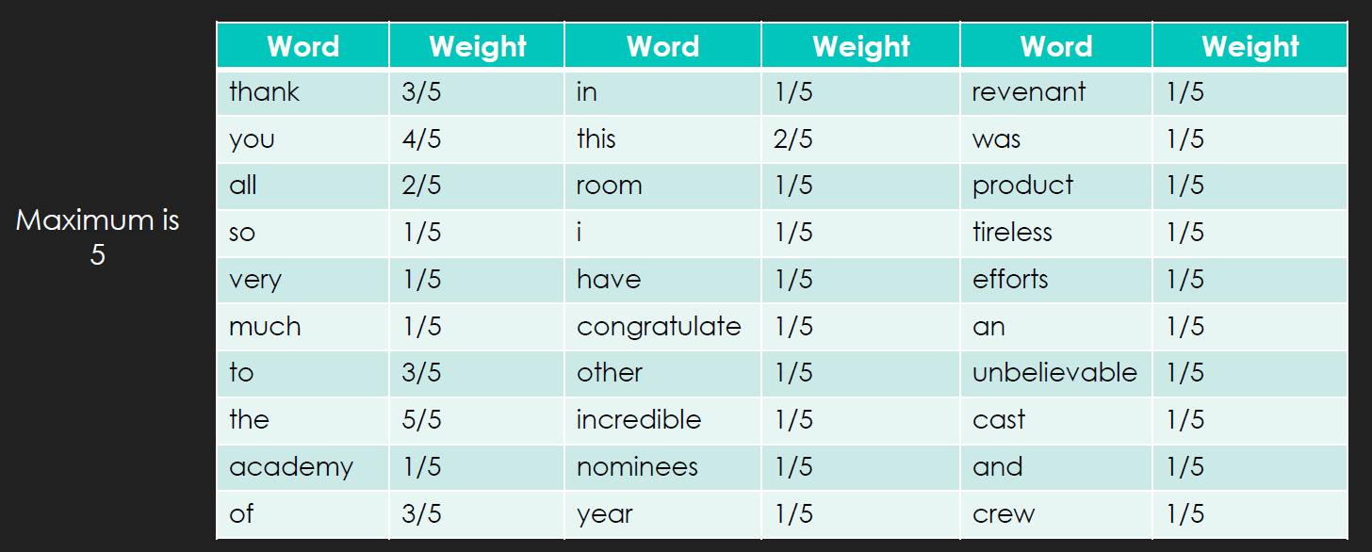

Slide 42
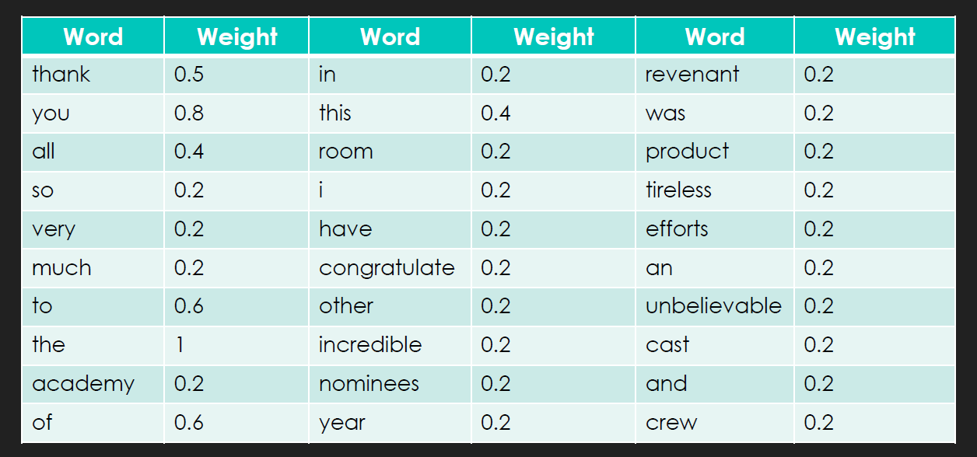

Slide 43
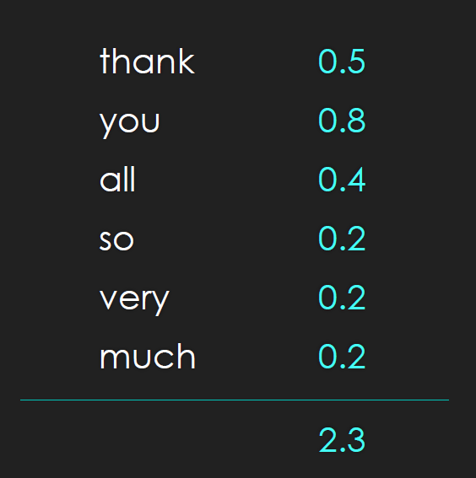

Slide 44
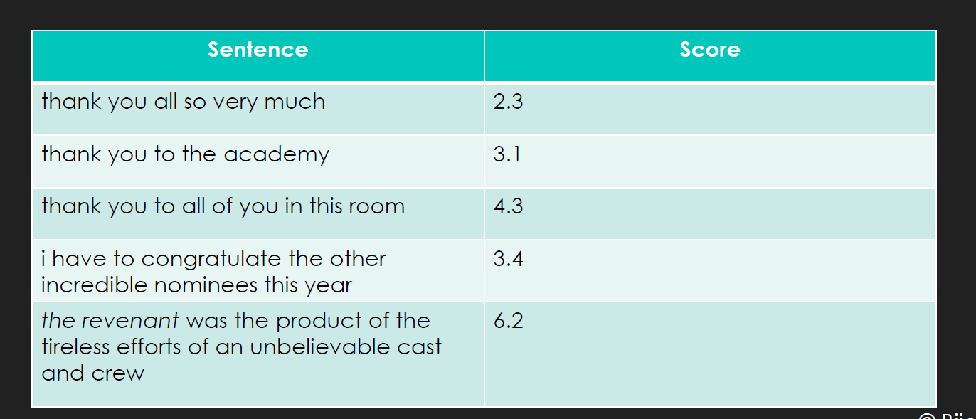

Slide 45
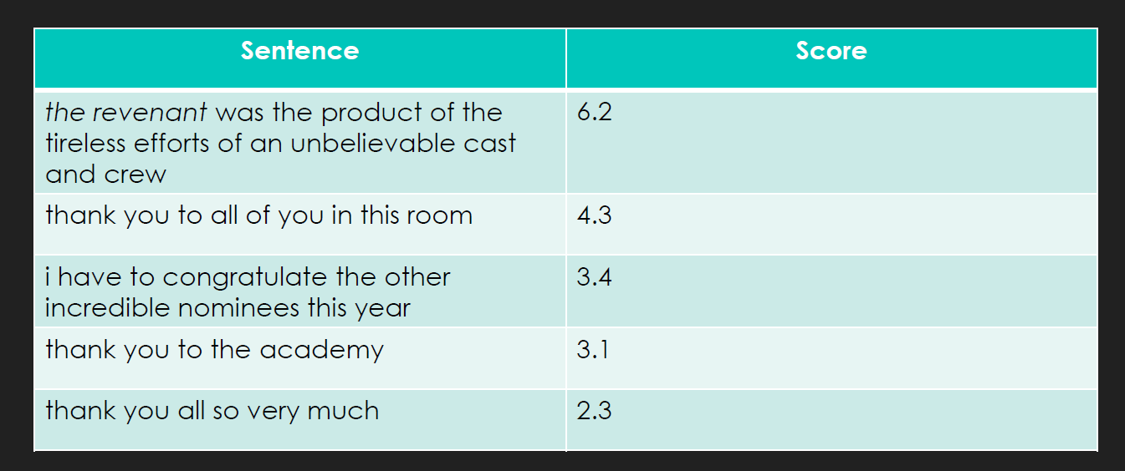

Slide 46
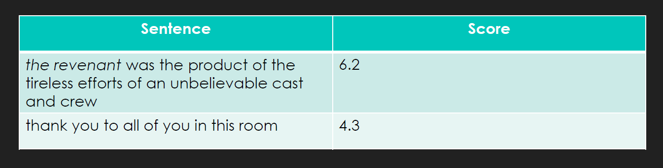

Slide 47
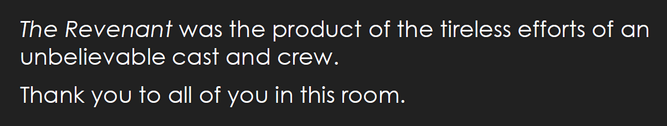

Slide 48
Thank You !!

Slide 49
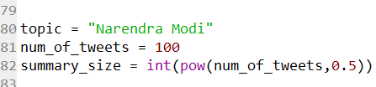
Input topic

Slide 50
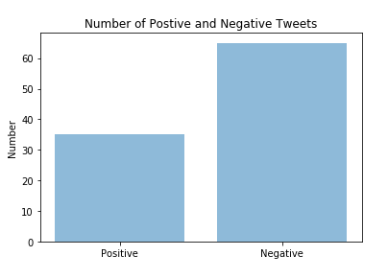
Graphical analysis

Slide 51
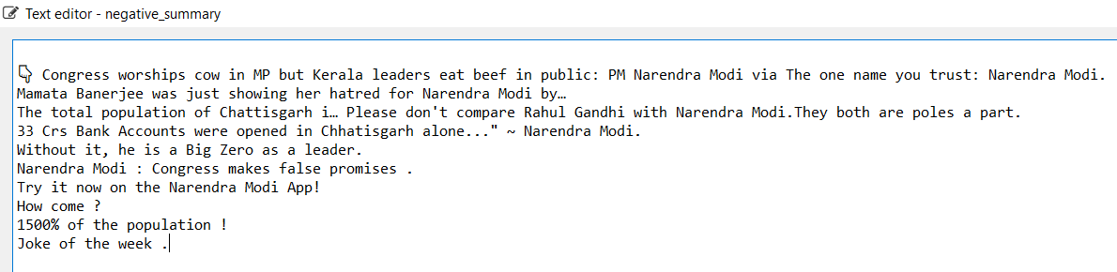
Negative Summary

Slide 52
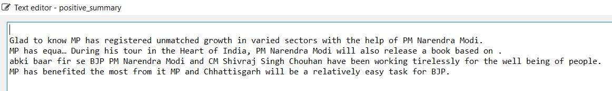
Positive Summary

